Slide 1
My Professional Portfolio
EEC 1921
Notes:
1

Slide 2
Autobiography

Slide 3
Competency Goal #1
To Establish and Maintain a Safe, Healthy Learning Environment:
Functional Area 1: Safe
To secure that the area is free of all hazardous materials. To reduce accidents from happening. Clean the areas daily, to prevent germs from spreading from one person to the other. Items that are labeled keep out of reach of children should be safely put away. Ensure that the fire extinguisher is in good condition and inspected. All CPR and First Aid certifications are up to date. All doorways are clear of debris and objects. Check the inside and outside area for anything that could harm children. Remove any broken equipment from the playground. Functional Area 2: Healthy
This environment helps the children to make healthy choices, by serving nutritious meals and snacks. The children have access to water throughout the day. Have exercise every day to promote movement. Teach them about hygiene and brush their teeth after meals. The children’s physical is up to date. The teachers should be healthy when in reach of the children and other staff. Clean the tables, chairs, walls and the doorknobs before
Functional Area 3: Learning Environment
The Learning Environment is teaching the children how to follow a schedule of the things that is next for them to do. Let the children help make a sign foe the class rules, this gives them responsibility of what they can and can not do in class. Have books, paper, pencils, crayons and materials in reach, so they can learn to help themselves. The environment should be inviting children curiosity. Learning areas should be fun, explored, social interaction and developmental for the children. In the learning area there should not be space for the children to run around inside. Have boundaries but enough room for the children to move freely in the space they are in.

Slide 4
Competency Goal #2
Candidate demonstrates sound judgment in sing the posted Weekly Schedule/Daily Plan
Follows the schedule daily, until the teacher or student finds a teachable moment, veers from schedule and plan as needed. Some time you may be teaching the children about animals, but if someone see a rainbow changing the lesson plan to what captured their interest. Effectively facilitates transitional times between activities. Uses a variety of strategies to transition children from one activity to another. We use singing, because most children learn with music better. And let them lead the song to keep them in line for the transition.
Functional Area 4: Physical
Because I have four- and five-year-olds, I use items like large bowling pen and balls, hopscotches, jump ropes, dodge ball, sac race and mother may I. The games they don’t usually see. Activities and materials encourage children of varying abilities to develop their small muscles. My students learn to tie their lace strings. We encourage our students to taste, smell and put their hands in the texture box. We make sure that there are no allergies. The texture box helps them use their cognitive skills, because they must tell us what they are feeling. Candidate’s facilitation promotes children’s physical development. My husband and I work together, and because a lot of children don’t have a mother and father in the home, we show them how we dance and act silly as a family. I think that’s what encouraged the parents to entrust their children with us. There is always someone with children in sight of an adult. Because every child is different and learns at their own pace, we don’t expect all the children to achieve a task at the same time. We do encourage them to try what we are teaching

Slide 5
Competency Goal #3
To Support Social and Emotional Development and to Provide Positive Guidance:
To support social and emotional development, Our Center allows the children the opportunity to choose their area of play. We have a variety of toys and games that enhance choosing a partner or working together that allows social skills. We also participate in their play, to show how working or playing together support social and emotional development. We show respectful and positive decisions in our choices. We play with the parachute, 4 square and fixing a large puzzle together.
Functional Area 8 Self
Space and activities help each child develop a sense of self-identity/worth. Our Center is well designed for self-identity. When children first come to our center, they must sign in themselves. The ones that know how to write will print their name on the attendance chart. They have their own cubbies with their names on them. We use colors to identify the children’s items. They know if it’s yellow it belongs to child a, and so on. We invite the families to share something that they do in their family culture. It may be in dance, food or language. This will allow the center to know something about their identity. Respects the child individuality of each child. The families all must make a Family Board that consist of things about the whole family with pictures. This is something that the child can see daily. We have noticed that this family board assures the child that they have confidence in what they need to achieve will happen because they see their family’s photo as support. The children are allowed to choose the area that they want to be in.
We call this time free choice. It’s a positive reaction because they made the choice themselves. We encourage the boys to play with dolls and cook. Encourages children’s self-help our center teaches the children when they first enter the class to wash their hands. They are to sit at the table for breakfast and serve themselves. When they are finished, they clean up after themselves and choose a learning center before circle time. Each child has a role in our center. The line leader, story time, teacher’s helper, assisting with the choirs and keeping track of when it’s time to transition. Because we keep the paper and art supplies at their level they can choose to write and color when they are ready.

Slide 6
Functional Area 9: Social
Materials, equipment and activities provided to help children experience working and playing in harmony. In one of our small groups, we gave each child large pieces of white paper, flower paddles, sequence pieces, glue, paint and car toys to roll and make tracks. This was a group assignment that taught the children how to work together.
Diverse activities our center meets once a month, where the families bring something from their culture to share with the whole center. We’ve had drummers from Africa, Island food from Jamaica, and I serve American soul food. Some of them dressed in their native attire. This is a non-bias activity that we have every year, as we get new families. Encourages children’s social interactions. We teach our children to help their classmates when they see or hear about a problem. Because we are a mixed age group center, our older children help the toddlers by reading books to them. They interact with each other, building block houses, roads and just stack them up. Our helpers take their jobs seriously.
Helps children understand their feelings and the feelings of others. I love the way that our children feel comfortable talking with my teachers and each other. We encourage the children to talk and tell us when they are happy or unhappy with the way someone treats them. We talk about their feelings when we have our small group time, to see how their day went. They can always come and express how they feel at any time. We talk about how respecting each other means. I need respect just like I need to respect them and their feelings. We show how we like for the children to treat us.
Functional Area 10: Guidance.
Spaces and materials provided anticipate children’s behavioral and developmental. We have a large home daycare. Because I’ve had the Daycare Centers, I have set up different learning centers that my home looks like a school setting. We use numbers for children so they know how many can be in that area. It’s spaced out enough that the children can move around comfortably, but there is no room to run. We the children take it upon themselves to make sure they clean up the areas they were in we let them know that they cleaned the Dramatic up area up very well. When it’s time to transition to another area, we start counting down by 10 minutes at a time, in case one might need to finish what they are doing.
Uses effective classroom management techniques. We have signs all around the center showing what area it is. When the children come in there’s a sign for our schedule with real children and the time we transition to that area. Every year I let the children help me make the sign for or rules. The children and I also write a song for that year. They love writing their names with the play-doh, it helps them know where to put the letters in their name.
Places emphasis on the development of self-discipline/self-regulation. When someone does not follow the rules, we remind the class of the sign we made together about the rules we will follow. If the children don’t follow the rules, we try a different mythic to see if that will help. The last result is to sit in the quit area, were there is books, paper, a toy and something that’s stuffed or squeezable.

Slide 7
Competency Goal #4
Various opportunities to appreciate and communicate with children’s families are included as part of the regular program
Functional Area 11: Families
We start school in August like the regular public schools. To support and show our family’s appreciation we invite the families to the Open House. We thank them for choosing our Center. We introduce everyone that works at our center so the parents and students will be familiar with them. Because there is culture difference, we discuss with them in our interview the things we expect from them as a part of our team. This will allow them to prepare for our open house. The families are expected to have a family board within two weeks of attending our center. We have pictures of the children’s family to help the child adjust to being away from their family. We respect their language if we have someone that can speak it. That is the reason we interview each family to assure that we are a good fit for their child. We have an open-door policy that families can come without an appointment.
We model respectful and positive communication with families. On the last day of the week, we serve coffee, juice, hot chocolate and donuts to our parents dropping off the children. We invite the families to come read a story to the children at Story time. We have a variety of volunteers that can fix things around the center. This enhances a partnership between the families and Us. We also participate assessing Their children monthly. The families take turns bringing an idea for family night. We share responsibility with the parents choosing an activity that’s comfortable for all families. The family’s photos help us to identify the family. Encourage families to a teacher parent conference be on the same page concerning their child. The parents will plan an activity that the center could benefit from. Offer support about health and nutrition. respect each other’s space. Every other month we have a parent’s night out, and we take care of the children while they are out.
We have resources for the families to take part in. Our center has a sliding scale when a parent is having a hard time paying their fees. We have an Annual Commencement every year for our Graduation Candidates.

Slide 8
Competency Goal #5

Slide 9
Competency Goal #6

Slide 10
Resource Page
Florida Abuse Hotline (24) Hours 1-800-962-2873
Wic. Office ………………………... 352-622-1161
Health Department Ocala…………..352-629-0137
Department of Children and Family..352-330-1377
Non-Emergency Police Department..352-368-5400
Ocala Housing Authority…………...352-620-3374

Slide 11
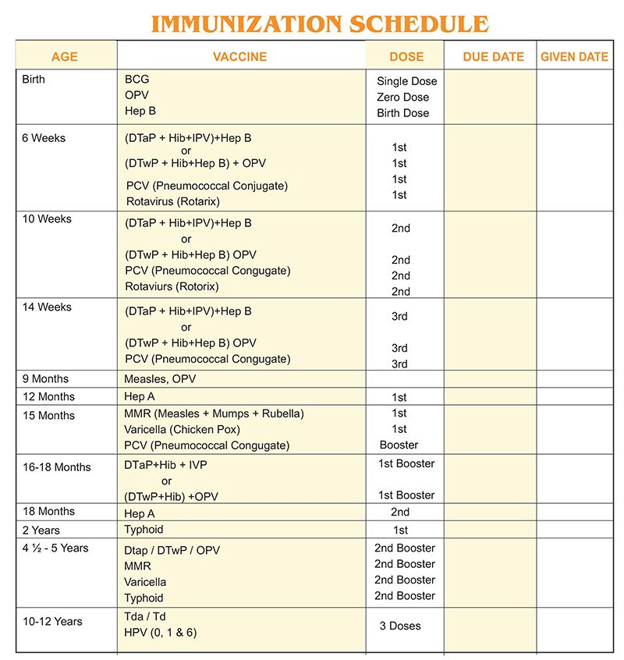
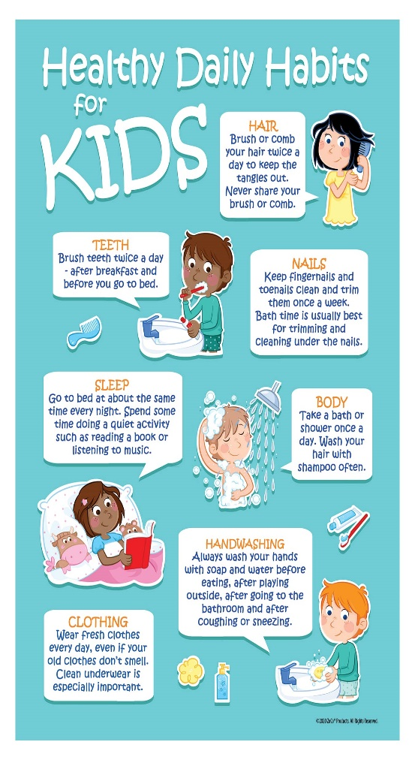
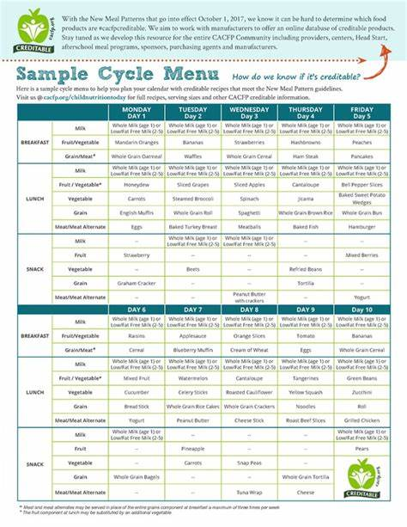
Charts That Contribute to Child’s Health

Slide 12
Autobiography - Template
Name:
Date:
My personal history includes…..
(where you were born, members of your family, where you went to school, etc.)
My experiences working with young children are…..
(informal such as babysitting or church, as well as your professional experiences)
My strengths are…..
My hobbies and areas of interest are…..
I am taking this training to learn…..
My goals for professional growth and development are…..
1.
2.
3.

Slide 13
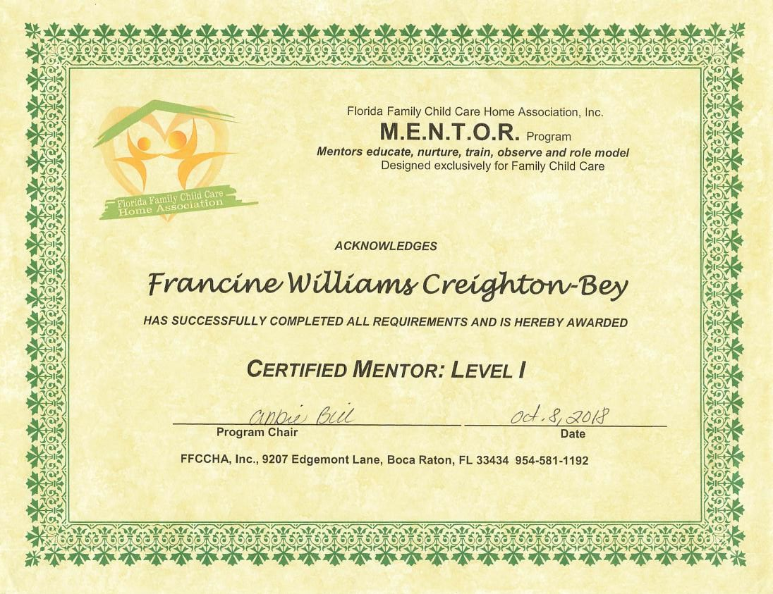

Slide 14
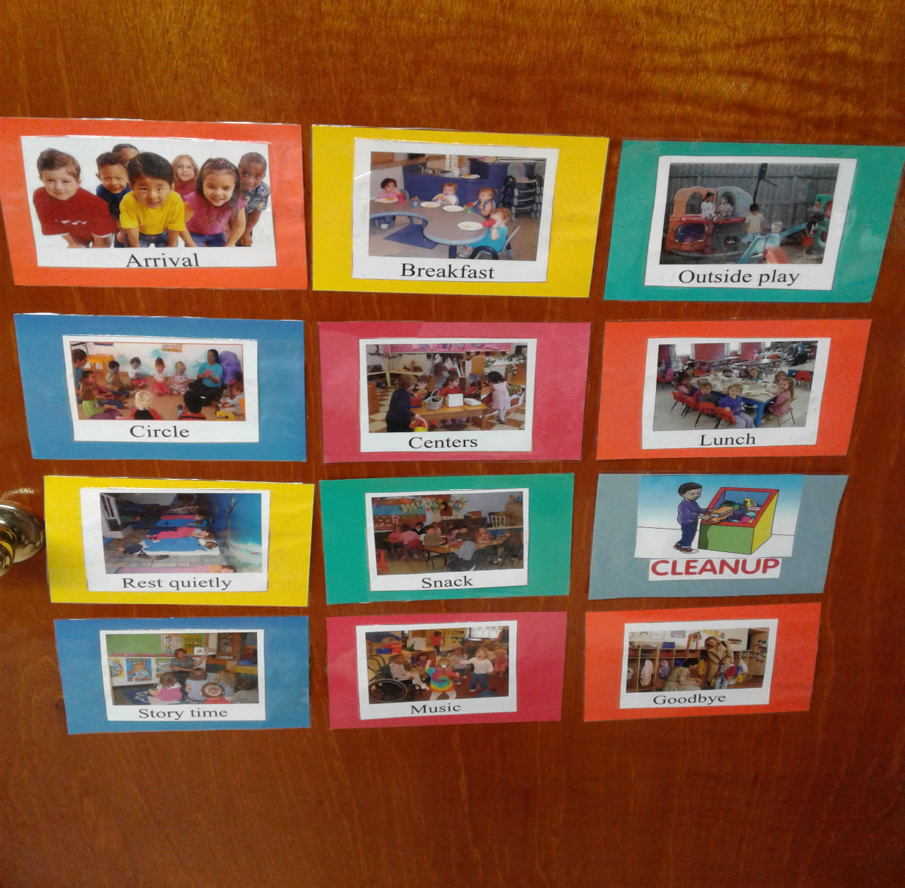
Routine for Class

